Slide 1
Cluster Management
Lecturer: Ngo Huy Bien
Software Engineering Department
Faculty of Information Technology
VNUHCM - University of Science
Ho Chi Minh City, Vietnam
nhbien@fit.hcmus.edu.vn

Slide 2

Objectives

Slide 3

Contents

Slide 4

References
Abhishek Verma et al. (2015). Large-scale Cluster Management at Google with Borg.
Yair Amir et al. (2000). An Opportunity Cost Approach for Job Assignment and Reassignment in a Scalable Computing Cluster.
John Wilkes (2013). Omega - Flexible, Scalable Schedulers for Large Compute Clusters.
Malte Schwarzkopf et al. (2013). Omega - Flexible, Scalable Schedulers for Large Compute Clusters.

Slide 5
The User Perspective [1]
Borg’s users are Google developers and system administrators (site reliability engineers or SREs) that run Google’s applications and services.
Users submit their work to Borg in the form of jobs, each of which consists of one or more tasks that all run the same program (binary).
Each job runs in one Borg cell, a set of machines that are managed as a unit.

Slide 6
The Workload
The first is long-running services that should “never” go down, and handle short-lived latency-sensitive requests (a few ms to a few hundred ms). Such services are used for end-user-facing products such as Gmail, Google Docs, and web search, and for internal infrastructure services (e.g., BigTable).
The second is batch jobs that take from a few seconds to a few days to complete; these are much less sensitive to short-term performance fluctuations.

Slide 7
Clusters and Cells
The machines in a cell belong to a single cluster, defined by the high-performance datacenter-scale network fabric that connects them.
A cluster lives inside a single datacenter building, and a collection of buildings makes up a site.
A cluster usually hosts one large cell and may have a few smaller-scale test or special-purpose cells.
Our median cell size is about 10 k machines after excluding test cells.

Slide 8
Jobs and Tasks
A Borg job’s properties include its name, owner, and the number of tasks it has.
Jobs can have constraints to force its tasks to run on machines with particular attributes such as processor architecture, OS version, or an external IP address.
A job runs in just one cell.
Each task maps to a set of Linux processes running in a container on a machine.
A task has properties too, such as its resource requirements and the task’s index within the job.

Slide 9
Job Descriptions
Most job descriptions are written in the declarative configuration language BCL. This is a variant of GCL. GCL provides lambda functions to allow calculations, and these are used by applications to adjust their configurations to their environment
Users operate on jobs by issuing remote procedure calls (RPCs) to Borg, most commonly from a command-line tool, other Borg jobs, or our monitoring systems.

Slide 10
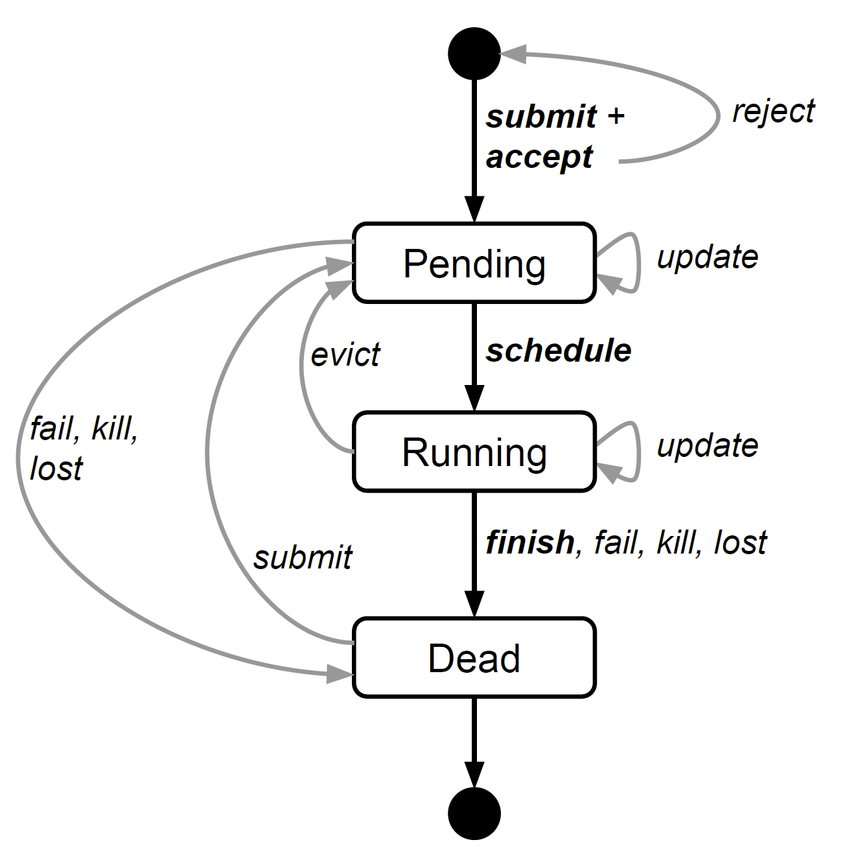
The Lifetime of Jobs and Tasks
The state diagram for both jobs and tasks.
Users can trigger submit, kill, and update transitions.

Slide 11
Allocs
A Borg alloc (short for allocation) is a reserved set of resources on a machine in which one or more tasks can be run; the resources remain assigned whether or not they are used.
An alloc set is like a job: it is a group of allocs that reserve resources on multiple machines.

Slide 12
Priority
Every job has a priority, a small positive integer.
A high-priority task can obtain resources at the expense of a lower-priority one, even if that involves preempting (killing) the latter.
Borg defines non-overlapping priority bands for different uses, including (in decreasing-priority order): monitoring, production, batch, and best eort (also known as testing or free).

Slide 13
Quota
Quota is used to decide which jobs to admit for scheduling.
Quota is expressed as a vector of resource quantities (CPU, RAM, disk, etc.) at a given priority, for a period of time (typically months).
Quota-checking is part of admission control, not scheduling: jobs with insufficient quota are immediately rejected upon submission.
Quota allocation is handled outside of Borg, and is intimately tied to our physical capacity planning, whose results are reflected in the price and availability of quota in different datacenters.

Slide 14
Naming
It’s not enough to create and place tasks: a service’s clients and other systems need to be able to find them, even after they are relocated to a new machine.
To enable this, Borg creates a stable “Borg name service” (BNS) name for each task that includes the cell name, job name, and task number.
Borg writes the task’s hostname and port into a consistent, highly-available file in Chubby with this name, which is used by our RPC system to find the task endpoint.
The BNS name also forms the basis of the task’s DNS name, so the fiftieth task in job jfoo owned by user ubar in cell cc would be reachable via 50.jfoo.ubar.cc.borg.google.com.

Slide 15
Monitoring
Almost every task run under Borg contains a built-in HTTP server that publishes information about the health of the task and thousands of performance metrics (e.g., RPC latencies).
Borg monitors the health-check URL and restarts tasks that do not respond promptly or return an HTTP error code.
Other data is tracked by monitoring tools for dashboards and alerts on service level objective (SLO) violations.

Slide 16


Slide 17
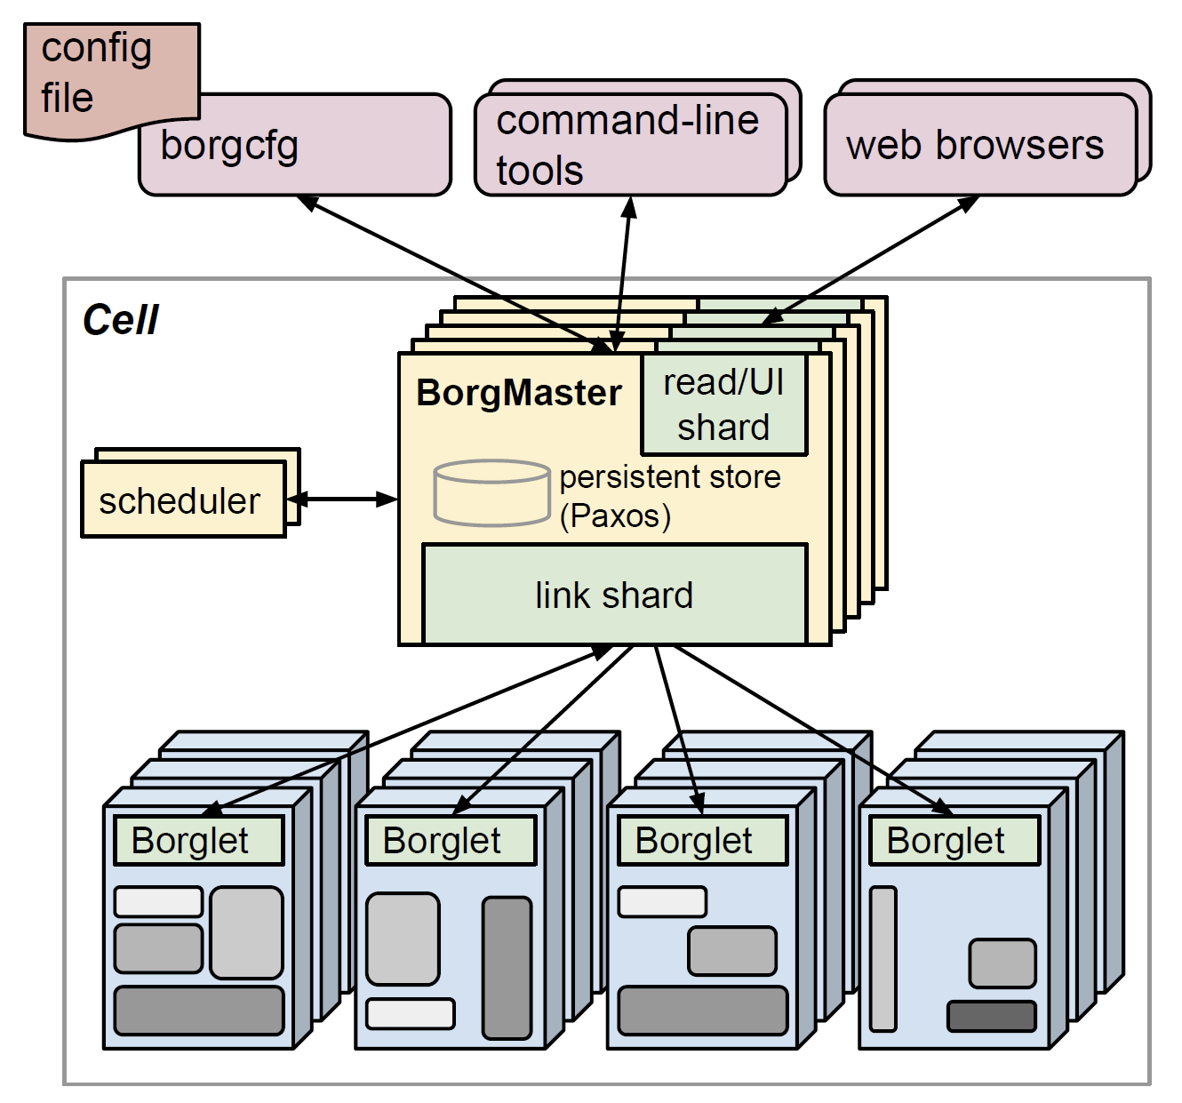
Borg Architecture
A Borg cell consists of a set of machines, a logically centralized controller called the Borgmaster, and an agent process called the Borglet that runs on each machine in a cell.

Slide 18
Borgmaster
The main Borgmaster process handles client RPCs that either mutate state (e.g., create job) or provide read-only access to data (e.g., lookup job).
The Borgmaster is logically a single process but is actually replicated five times.

Slide 19
Scheduling
When a job is submitted, the Borgmaster records it persistently in the Paxos store and adds the job’s tasks to the pending queue.
This is scanned asynchronously by the scheduler, which assigns tasks to machines if there are sufficient available resources that meet the job’s constraints.
(The scheduler primarily operates on tasks, not jobs.)
The scheduling algorithm has two parts: feasibility checking, to find machines on which the task could run, and scoring, which picks one of the feasible machines.

Slide 20
"Worst fit" Scoring
Borg originally used a variant of E-PVM for scoring, which generates a single cost value across heterogeneous resources and minimizes the change in cost when placing a task.
In practice, E-PVM ends up spreading load across all the machines, leaving headroom for load spikes – but at the expense of increased fragmentation, especially for large tasks that need most of the machine; we sometimes call this “worst fit”.

Slide 21
"Best fit" Scoring
The opposite end of the spectrum is “best fit”, which tries to fill machines as tightly as possible.
This leaves some machines empty of user jobs (they still run storage servers), so placing large tasks is straightforward, but the tight packing penalizes any mis-estimations in resource requirements by users or Borg.
This hurts applications with bursty loads, and is particularly bad for batch jobs which specify low CPU needs so they can schedule easily and try to run opportunistically in unused resources: 20% of non-prod tasks request less than 0.1 CPU cores.

Slide 22
Hybrid Approach
Our current scoring model is a hybrid one that tries to reduce the amount of stranded resources – ones that cannot be used because another resource on the machine is fully allocated.
It provides about 3–5% better packing efficiency than best fit for our workloads.
See Abhishek Verma et al. (2014). Evaluating job packing in warehouse-scale computing.

Slide 23
Borglet
The Borglet is a local Borg agent that is present on every machine in a cell.
It starts and stops tasks; restarts them if they fail; manages local resources by manipulating OS kernel settings; rolls over debug logs; and reports the state of the machine to the Borgmaster and other monitoring systems.

Slide 24
Statless Link Shard
For performance scalability, each Borgmaster replica runs a stateless link shard to handle the communication with some of the Borglets; the partitioning is recalculated whenever a Borgmaster election occurs.
For resiliency, the Borglet always reports its full state, but the link shards aggregate and compress this information by reporting only differences to the state machines, to reduce the update load at the elected master.

Slide 25
Rescheduled Tasks
If a Borglet does not respond to several poll messages its machine is marked as down and any tasks it was running are rescheduled on other machines.
If communication is restored the Borgmaster tells the Borglet to kill those tasks that have been rescheduled, to avoid duplicates.
A Borglet continues normal operation even if it loses contact with the Borgmaster, so currently-running tasks and services stay up even if all Borgmaster replicas fail.

Slide 27
Scalability
Early versions of Borgmaster had a simple, synchronous loop that accepted requests, scheduled tasks, and communicated with Borglets.
To handle larger cells, we split the scheduler into a separate process so it could operate in parallel with the other Borgmaster functions that are replicated for failure tolerance.
To improve response times, we added separate threads to talk to the Borglets and respond to read-only RPCs. For greater performance, we sharded (partitioned) these functions across the five Borgmaster replicas (link shards).

Slide 28
Communication between the Scheduler and the Elected master
A scheduler replica operates on a cached copy of the cell state.
It repeatedly: retrieves state changes from the elected master (including both assigned and pending work); updates its local copy; does a scheduling pass to assign tasks; and informs the elected master of those assignments.
The master will accept and apply these assignments unless they are inappropriate (e.g., based on out of date state), which will cause them to be reconsidered in the scheduler’s next pass.

Slide 29
Availability
Failures are the norm in large scale systems.
Applications that run on Borg are expected to handle such events, using techniques such as replication, storing persistent state in a distributed file system, and (if appropriate) taking occasional checkpoints.
A key design feature in Borg is that already-running tasks continue to run even if the Borgmaster or a task’s Borglet goes down.

Slide 31
Notes: Scheduling Goals (I)
Performance (Job/Workload Efficiency)
Achieve low job response times and high throughput (e.g., minimize makespan, average completion time).
Resource Utilization and Efficiency
Maximize use of available cluster resources (CPU, memory, GPUs, etc.) to reduce idle capacity.
Workload Accommodation / Balancing
Ensure heterogeneous workloads (batch, interactive, latency-sensitive) are supported effectively, and work is balanced across nodes to avoid bottlenecks.

Slide 32
Notes: Scheduling Goals (II)
Fairness and Service Guarantees
Allocate resources such that no tenant/starves, and fairness is maintained across jobs or users.
Scalability and Adaptability
Schedulers should scale with cluster size and adapt to dynamic workload changes (arrival patterns, resource failures, etc.).

Slide 33
Bin Packing Algorithms
(1974). Fast Algorithms for Bin Packing.
(1984). Approximation Algorithms for Bin Packing - A Survey.

Slide 34
The Job Assignment Model [2]
The goal of this work is to improve performance in a cluster of n machines, where machine i has a CPU resource of speed r_{c}(i) and a memory resource of size r_{m}(i).
There is a sequence of arriving jobs that must be assigned to these machines. Each job is defined by three parameters:
Its arrival time, a(j),
The number of CPU seconds it requires, t(j), and
The amount of memory it requires, m(j).
We assume that m(j) is known when a job arrives, but t(j) is not. A job must be assigned to a machine immediately upon its arrival, and may or may not be able to move to another machine later.

Slide 35
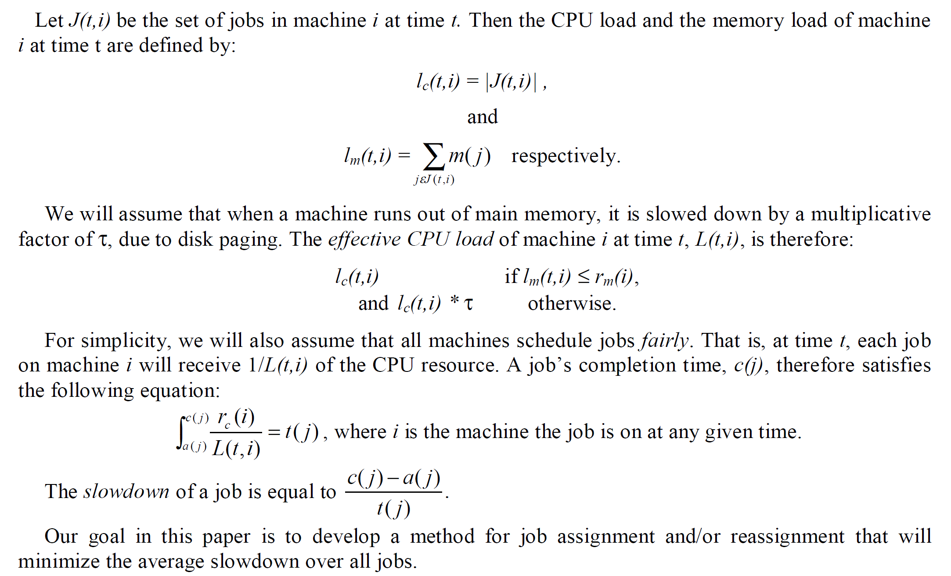
The Goal: Minimizing the average slowdown over all jobs

Slide 36
Parallel Virtual Machine
PVM (for “Parallel Virtual Machine”) is a popular metacomputing environment for systems without preemptive process migration.
Unless the user of the system specifically intervenes, PVM assigns jobs to machines using a strict Round-Robin strategy.
It does not reassign jobs once they begin execution.

Slide 37
Enhanced PVM
Enhanced PVM is our modified version of PVM.
It uses the opportunity cost-based strategy to assign each job as it arrives to the machine where the job has the smallest marginal cost at that time.
No other factors come into play.
As with PVM, initial assignments are permanent.
We sometimes abbreviate Enhanced PVM as E-PVM.

Slide 38
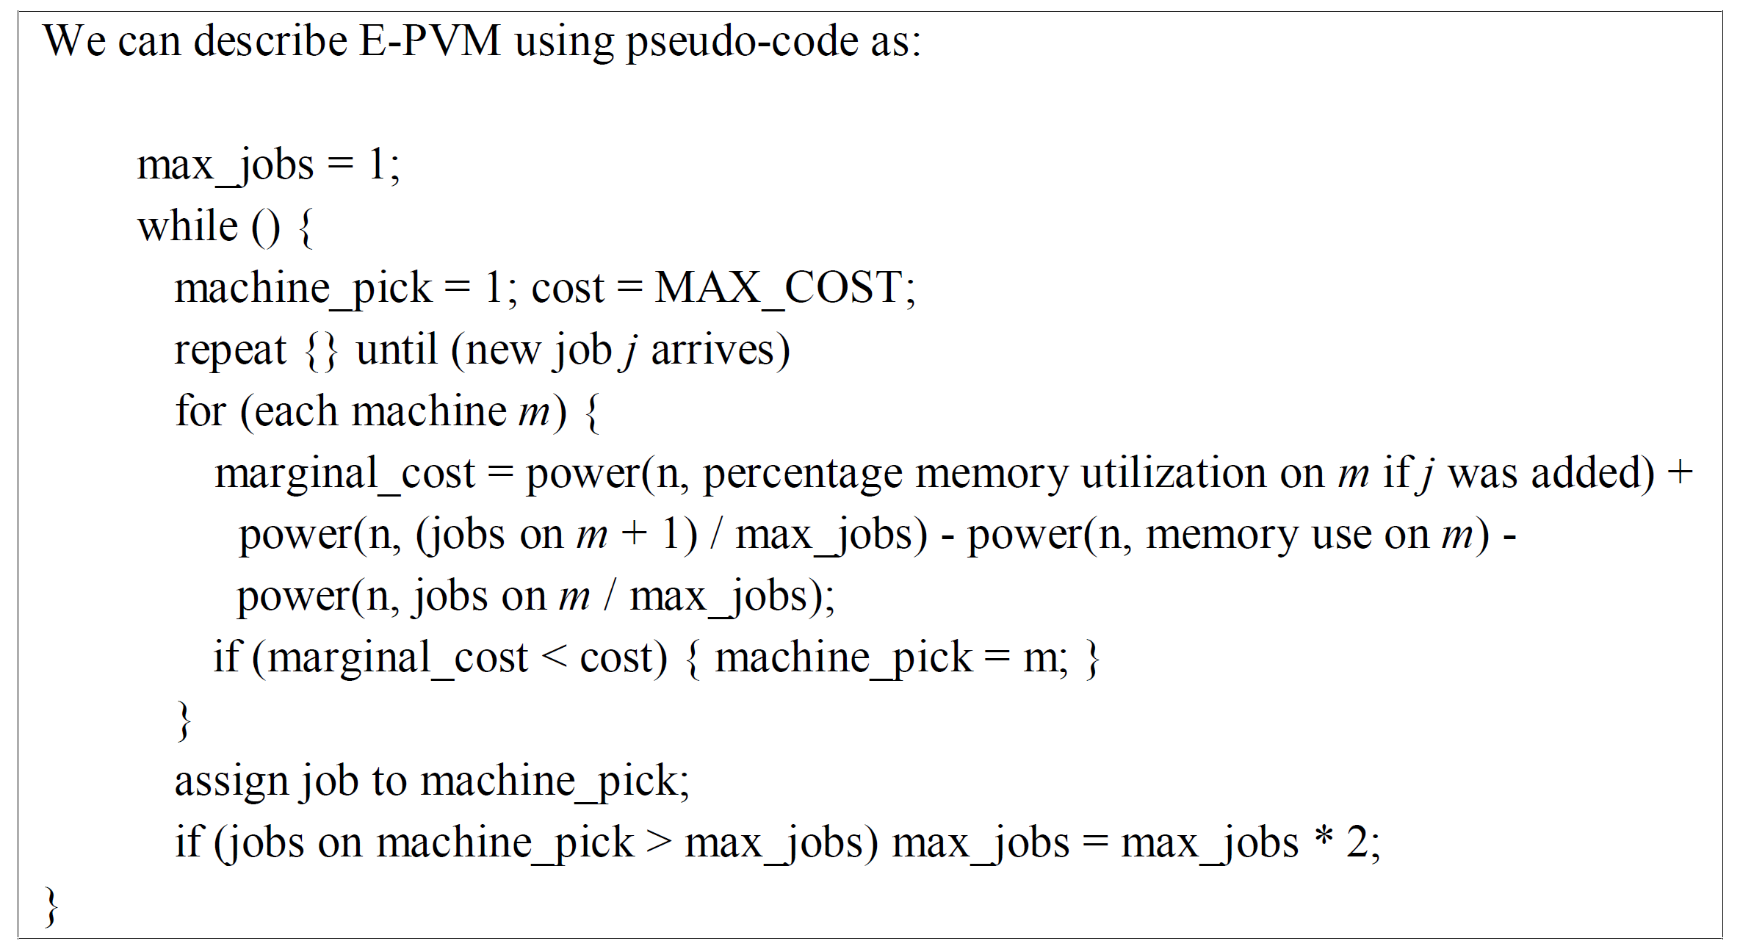
E-PVM Pseudo-Code

Slide 40
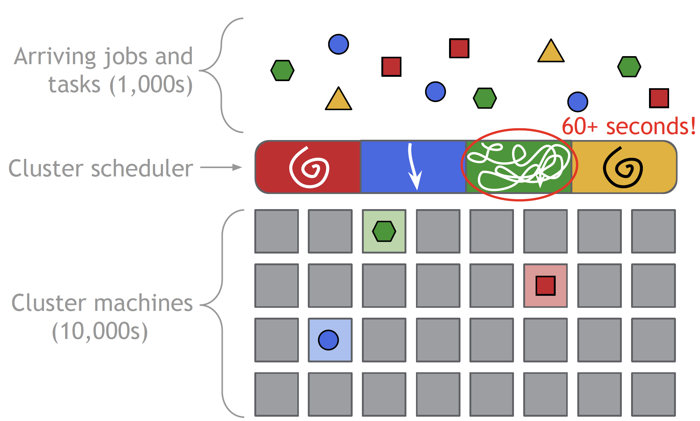
Mix of Workloads [3]

Slide 41
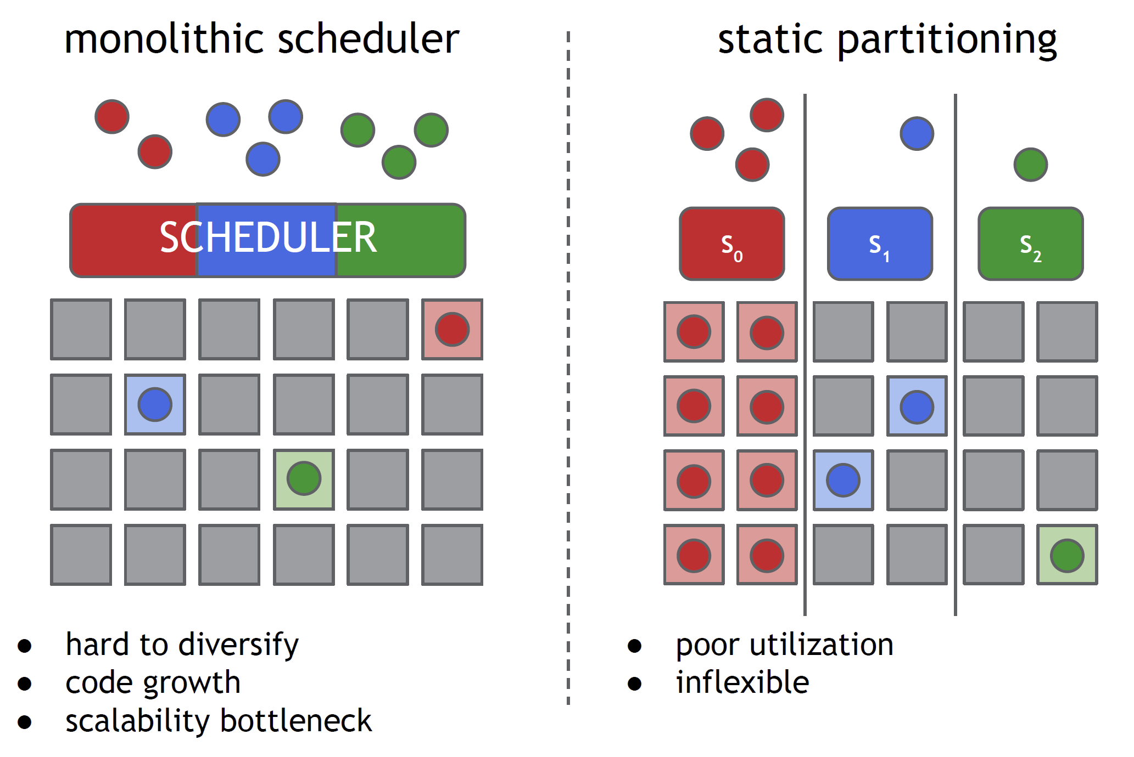
Existing Approaches (I)

Slide 42
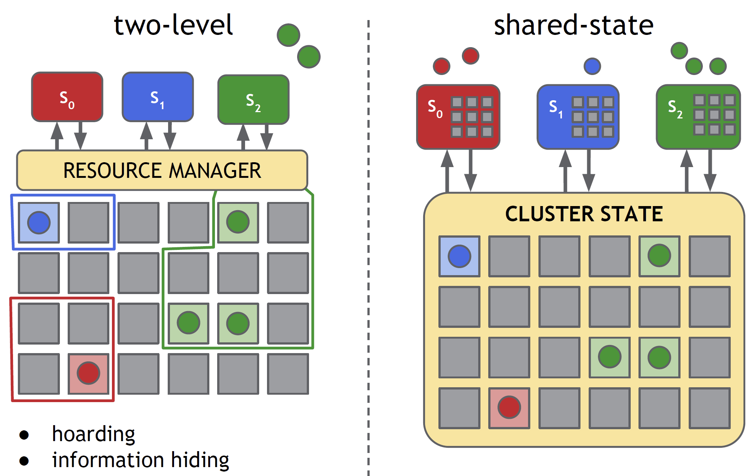
Existing Approaches (II)

Slide 43
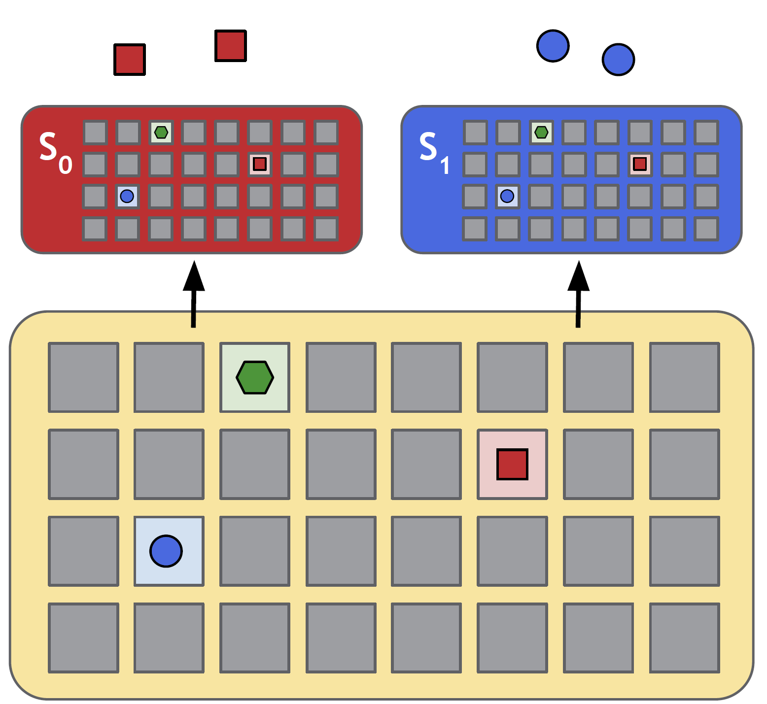
How Omega Works

Slide 44
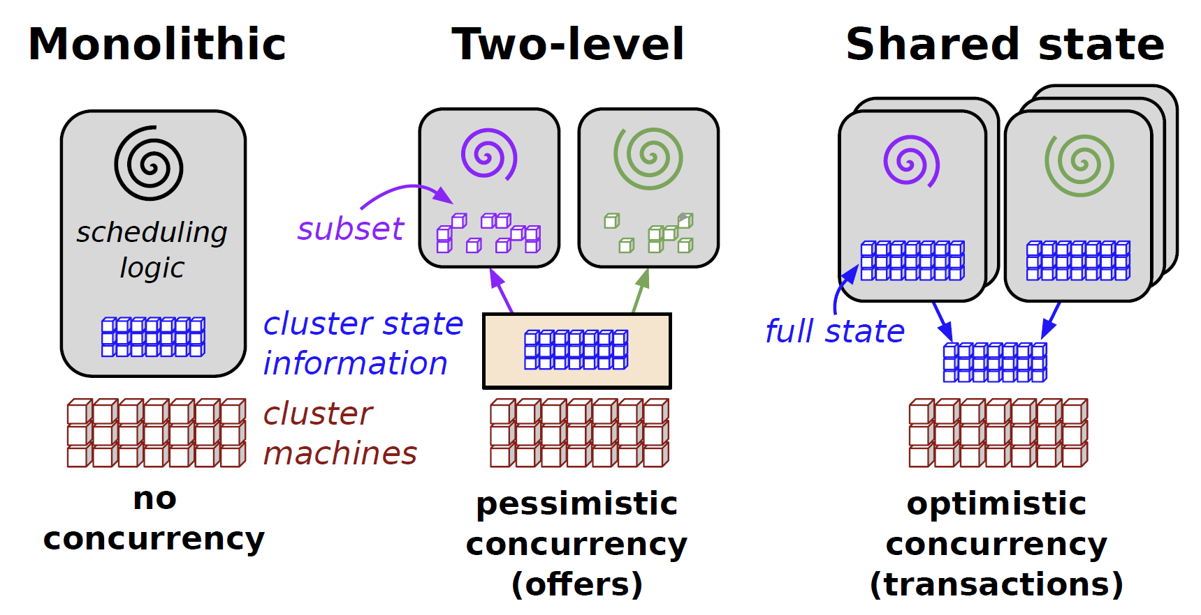
Scheduler Architectures [4]
The problem: Mix of workloads.
Focus: Only schedulers.

Slide 45
Monolithic Schedulers
Monolithic schedulers use a single, centralized scheduling algorithm for all jobs.
Monolithic schedulers do not make it easy to add new policies and specialized implementations, and may not scale up to the cluster sizes.

Slide 46
Two-level Schedulers
Two-level schedulers have a single active resource manager that offers compute resources to multiple parallel, independent "scheduler frameworks".
Two-level scheduling architectures do appear to provide flexibility and parallelism, but in practice their conservative resource-visibility and locking algorithms limit both, and make it hard to place difficult to schedule “picky” jobs or to make decisions that require access to the state of the entire cluster.

Slide 47
Omega
Our solution is a new parallel scheduler architecture built around shared state, using lock-free optimistic concurrency control, to achieve both implementation extensibility and performance scalability.
There is no central resource allocator in Omega; all of the resource-allocation decisions take place in the schedulers.
We maintain a resilient master copy of the resource allocations in the cluster, which we call cell state.

Slide 48
Transaction
The scheduler can see the entire state of the cell and has complete freedom to lay claim to any available cluster resources provided it has the appropriate permissions and priority – even ones that another scheduler has already acquired.
Once a scheduler makes a placement decision, it updates the shared copy of cell state in an atomic commit.
At most one such commit will succeed in the case of conflict: effectively, the time from state synchronization to the commit attempt is a transaction.
Whether or not the transaction succeeds, the scheduler resyncs its local copy of cell state afterwards and, if necessary, re-runs its scheduling algorithm and tries again.

Slide 49
Resource Allocations
Different Omega schedulers can implement different policies, but all must agree on what resource allocations are permitted (e.g., a common notion of whether a machine is full), and a common scale for expressing the relative importance of jobs, called precedence.
Individual schedulers have configuration settings to limit the total amount of resources they may claim, and to limit the number of jobs they admit.
Finally, we also rely on postfacto enforcement, since we are monitoring the system’s behavior anyway.
(Postfacto enforcement in the context refers to a form of enforcing resource-allocation policies after the scheduling decisions have been made and actions have executed)

Slide 50

Thank You & See You Again

